Slide 1
Updates to By-laws
Bryan Ackland

Slide 2
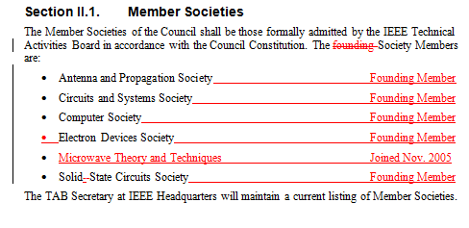
Proposed Changes to By-laws (1)
© 2006 IBM Corporation

Slide 3
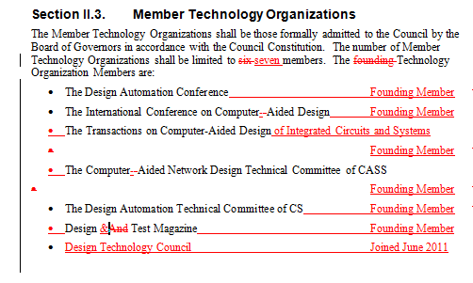
Proposed Changes to By-laws (2)
© 2006 IBM Corporation

