Slide 1
CEDA Standards Committee
Dennis Brophy
5 December 2021

Slide 2
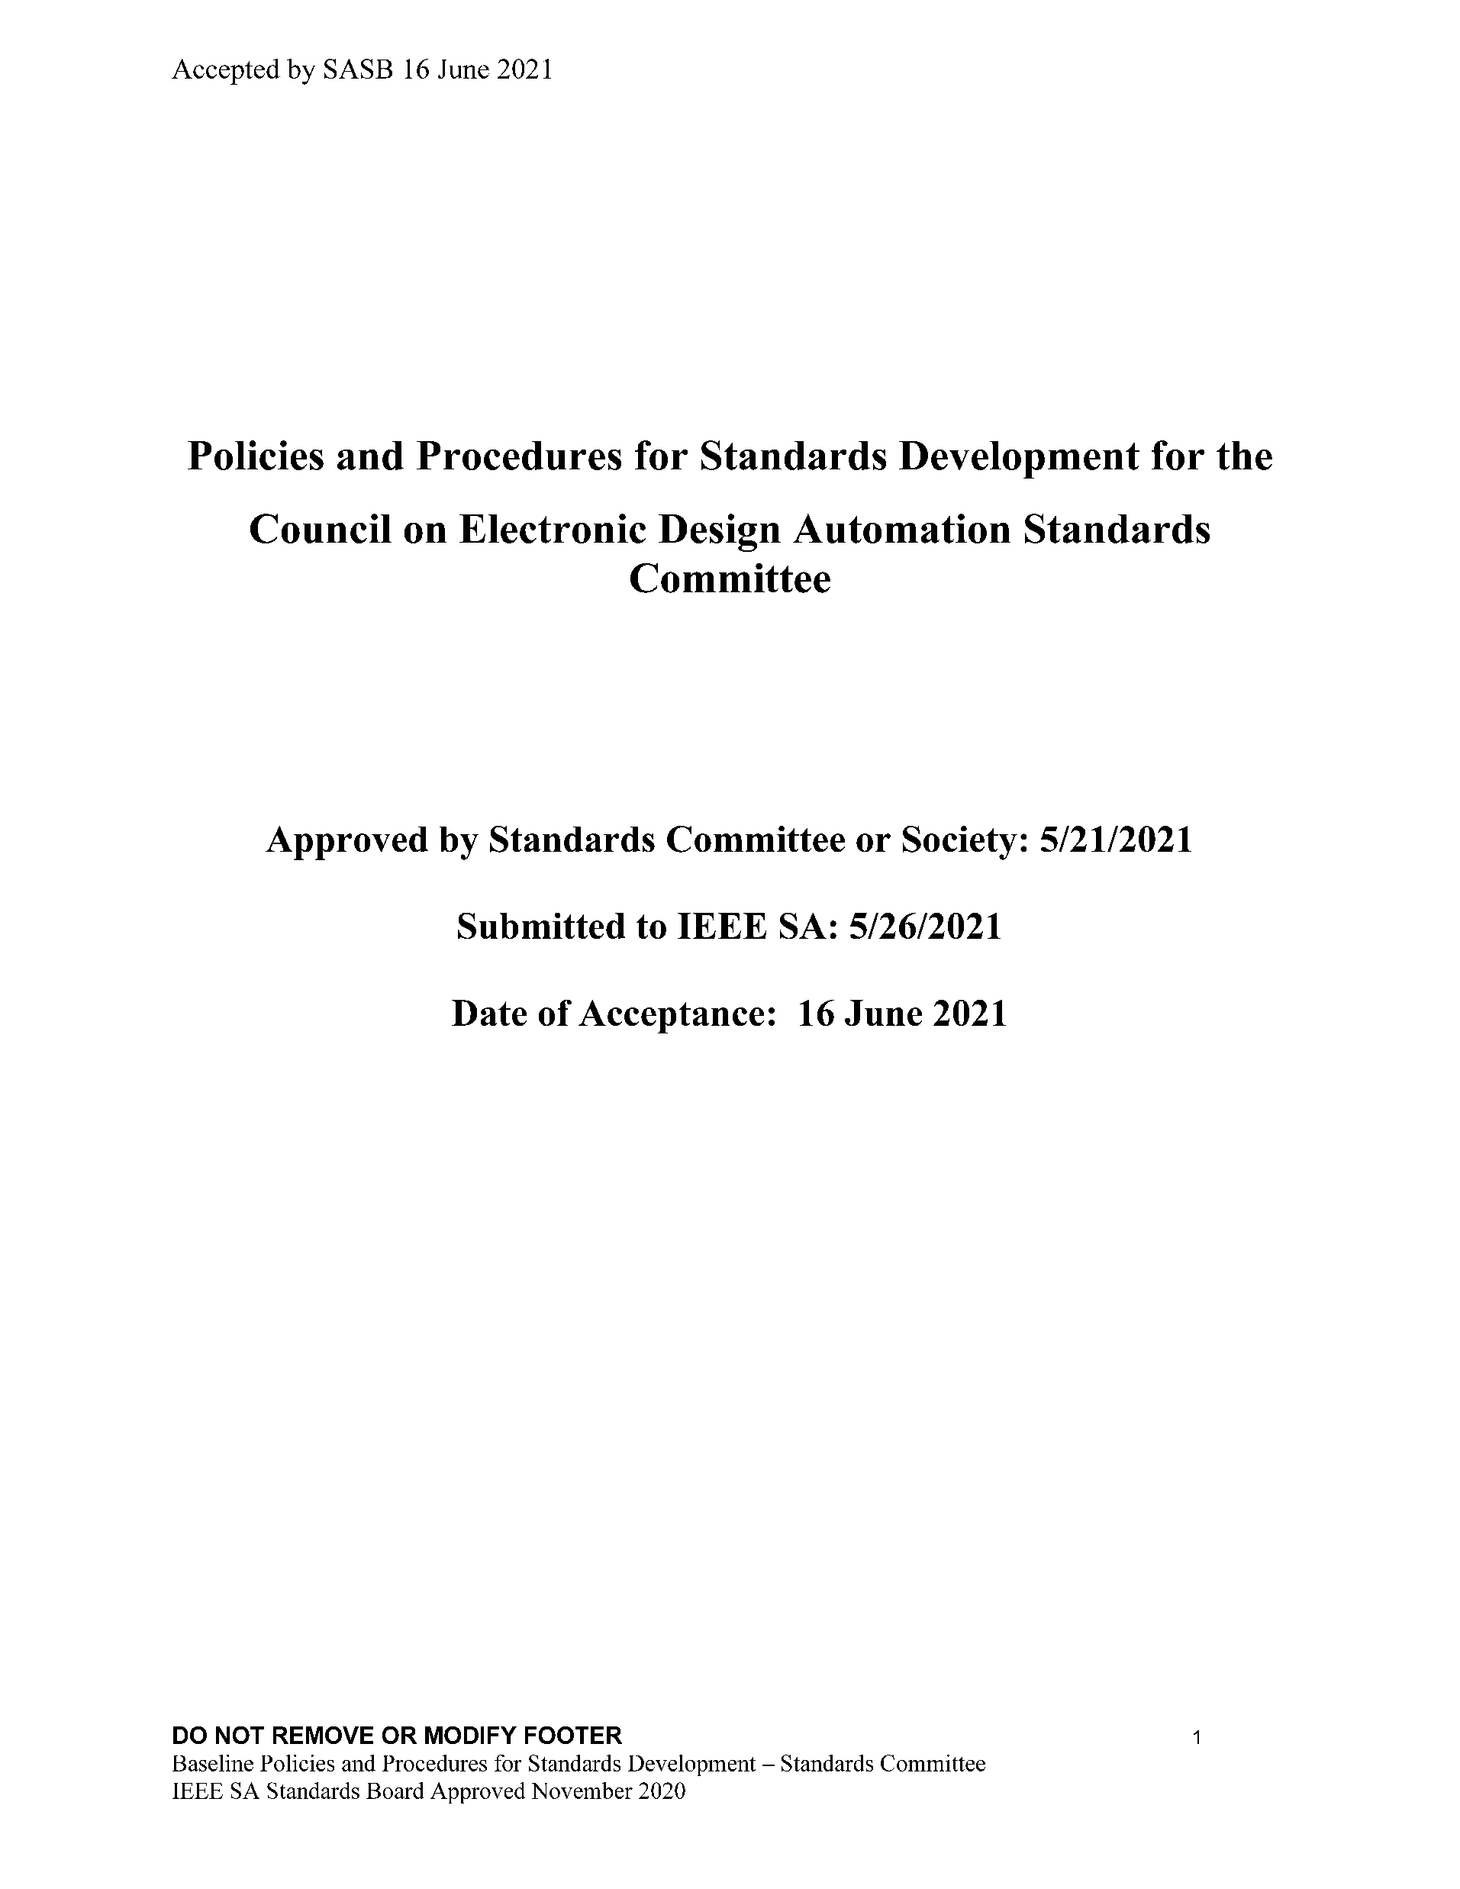
Current Status & Achievements
CEDA Standards Committee (CEDA SC) Authorized (June 2021)
CEDA SC Leadership
Dennis Brophy, chair (CEDA Standards VP)
Aparna Dey, vice-chair (CEDA Standard VP 2022)
Yatin Trivedi, secretary
CEDA SC Open-Source Maintainer
Dennis Brophy

Slide 3
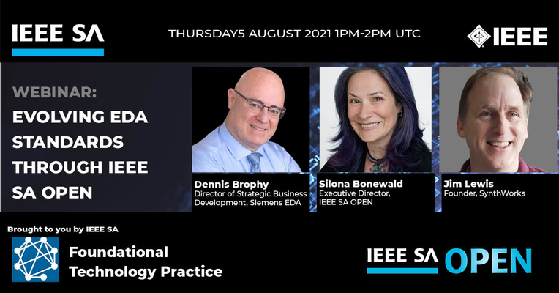
Current Status & Achievements (2)
Shared IEEE SA Open with CEDA Asia Chapters (webinar) 8/2021
Plan CEDA SC membership offer to CEDA Chapter members; start with Asia
Europe Winter 2022
North America Summer 2022 (DAC)

Slide 4
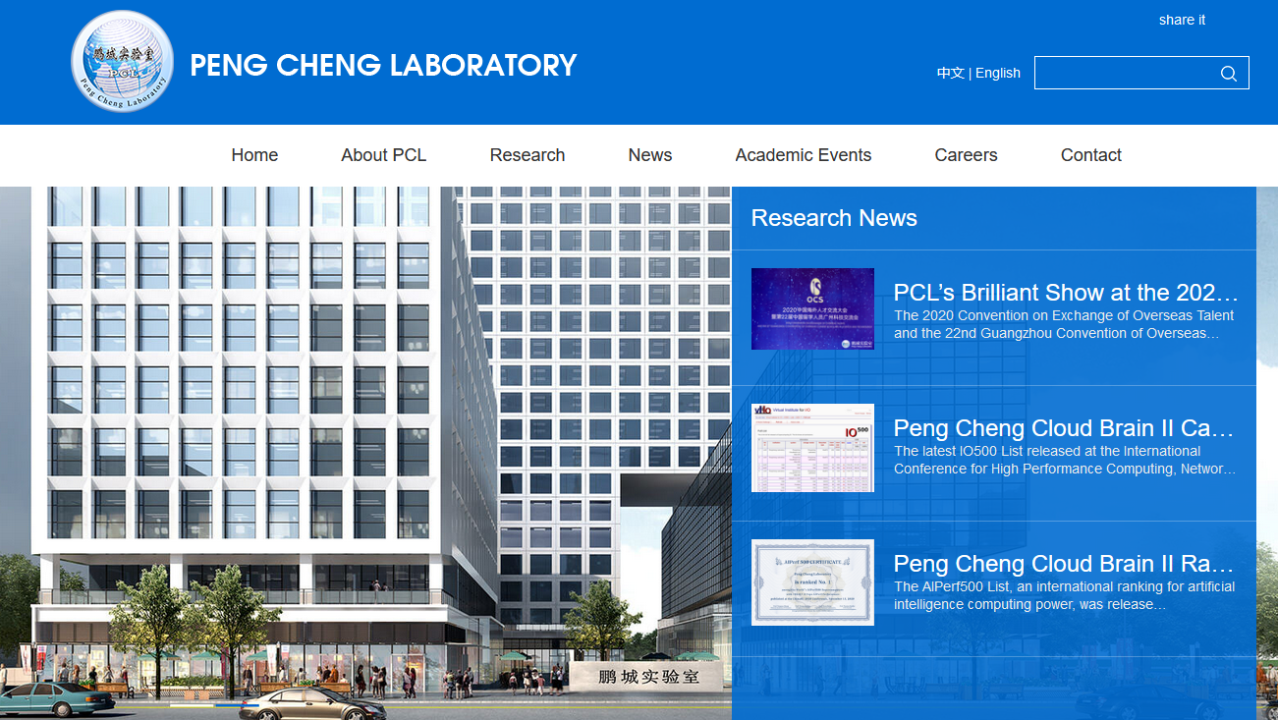
Challenges (1)
Design Automation Standards Committee (DASC) in discussions with CEDA SC on request to sponsor a new standard
Titled: “Semiconductor Devices Modeling & Measurements”
Initiated as an entity project by Xiaoxu Luan at Peng Cheng Laboratory (Shenzhen CN)
Similar to work by academic community in Si2’s Compact Modeling Coalition

Slide 5
Challenges (2)
Different Scope
The CMC Si2 provides standardized compact models for silicon MOSFET/ GaN HEMT/FinFET/ Gate-All-Around FET/FDSOI etc. Such models are mainly developed for Silicon/GaN based VLSI design.
Proposed new standard to focus on IGZO-driven-display, FeFET-driven-DRAM or RRAM-driven-neuromorphic-computing etc.
The reason for launching this standard is very simple: In researching new devices and their integrated design technology, we noticed that how big a display industry is, but standards for process extraction and oxide-TFTs are still lacking due to different process flows and device physical properties. We believe it is significant to establish a standard in the field.
Our group have hosted CAD-TFT conference, owned publications on such new devices in IEEE IEDM/VLSI and fabricated memory chips. What’s more, we have good relations of cooperation with leading companies like BOE and CSOT, which makes us quite confident in this standard. Moreover, such oxide-based devices are BEOL- compatible and supports future Chiplet-tech. And it is promising in boosting the future IC design technology.

Slide 6
Challenges (3)
DASC and CEDA SC will most likely conclude this should be a CEDA SC project give the “research” nature of it and the close connection to the global CEDA academic community.
Could be our first CEDA SC standard…

Slide 7
Action Items
Change of leadership beginning 2022
Remain connected and committed to CEDA SC operation to drive adoption of IEEE SA Open platform based on interactions with CEDA Chapters (first half of 2022)
Grow CEDA SC membership

Slide 8
Questions?

