Slide 1
Publications
L. Miguel Silveira, INESC-ID / IST - U Lisboa, Portugal
Naehyuck Chang, School of Electrical Eng., KAIST, South Korea
Luigi Carro, Dept. Informatics, UFRGS, Brazil
Rajesh Gupta, Dept. CSE, UC San Diego, USA, (EiC TCAD)
Joerg Henkel, Embedded Systems, KIT, Germany, (EiC D&T)
Sri Parameswaran, Schold of CSE, UNSW, Australia, (EiC ESL)
Sachin Sapatnekar, Dept. ECE, U Minnesota, USA
L. Miguel Silveira, INESC-ID/IST - U Lisboa, Portugal (CEDA VP Pubs)
Publications Committee

Slide 2
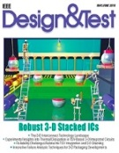
CEDA Participation in Periodicals
Financial co-sponsor:
Design & Test magazine
Sole financial sponsor:
Embedded Systems Letters (ESL)
Trans. Computer-Aided Design (TCAD)
Technical co-sponsor:
TMSCS
JxCDC
TSUSC

Slide 3
Timeline of focus activities
2017-H2 | 2018-H1 | 2018-H2 | 2019-H1 | 2019-H2 | 2020-H1
A | I | I
B | D |  | G | B
C | E |  | J | C
 |  | F |  | H
 |  | K | K | K
A | Aftermath of failure of TESS proposal
B | Search/Reappointment of ESL EiC
C | Search/Reappointment of TCAD EiC
D | ESL PRAC Review
E | TCAD PRAC Review
F | D&T Intermediate Review
G | ESL Impact Factor - Clarivite
H | Search/Reappointment of D&T EiC
I | Analysis of TMSCS situation
J | Evaluation of TCAD's status
K | TCAD - Assessment of publication model

Slide 4
Ongoing & Upcoming Activities
Attempts to launch new publications failed (TESS)
Use TCAD as a springboard into Embedded/Cyberphysical Systems
Consider other possibilities moving forward
Investigating new publication model from 2017 onward:
2018: TCAD hosts ESWeek (~700-1000 extra pages)
Possibly to continue in even years, alternate with ACM TECS
Similar model with ICCAD under preliminary discussion
ESL EIC 2018-2019 reappointed, board revised
TCAD EIC 2018-2019 appointed, board setup
PRAC reviews of TCAD and ESL conducted
Successful, no major issues
Extra PRAC report on D&T progress due 09/2018

Slide 5
Strategic Tasks
ESL growth, Impact Factor/Thomson Reuters metrics
TCAD development, embedded and cyberphysical systems topics
D&T financial turn around
Readership enhancement
Consider new possibilities in areas of growth
Embedded Systems, embedded software
Nano technologies

Slide 6
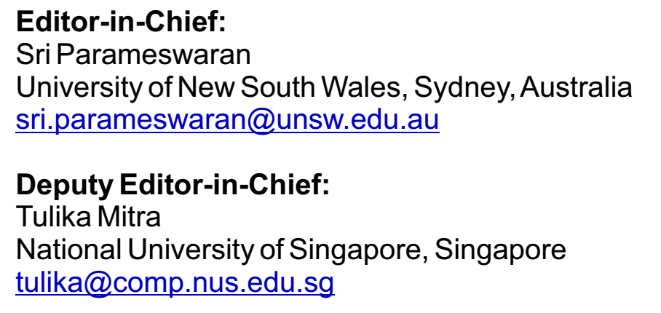
ESL - Introduction
Financial sponsor: CEDA
Started in 2009
Received approximately 175 submissions a year
Four pages only
Four issues per year
Strive for quick turnaround
Room to grow: initiatives underway
Finance, size, attention (click counts), submission-to-publication times, publication dates: healthy/stable

Slide 7
ESL - Updates
Successfully went through PRAC earlier this year
In 2016 was included in Clarivate Analytics’ Emerging Sources Citation Index (formerly Thomson Reuters IP and Science)
Beginning with V8 (1) 2016, this publication will be indexed and abstracted in:
Science Citation Index Expanded (also known as SciSearch®)
Journal Citation Reports/Science Edition
Current Contents®/Engineering Computing and Technology
Just announced

Slide 8
ESL - Other Initiatives
Perspective papers
Starting to receive submissions and four published so far.
Special Issues were introduced
Approximate Computing (published)
IEEE International Symposium on Real-Time Computing –Selected Papers
Embedded Security Challenge
Five of the top papers are packaged for ESL
Emerging Topics in Secure and Trustworthy Cyber-Physical Systems

Slide 9
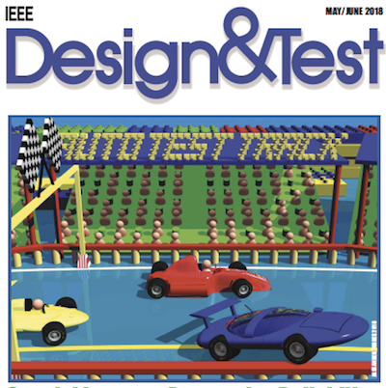
Design & Test Introduction
Financial sponsors: SSCS, CASS, CEDA
Technical sponsor: TTTC
Most composed of Special Issues,
Surveys and Tutorial papers
Very popular department articles
Editor in Chief:
Jörg Henkel
Karlsruhe Institute of Technology (KIT), Karlsruhe, Germany
henkel@kit.edu
Associate EiC:
Partha Pande
Washington State University, WA, U.S.A.
pande@eecs.wsu.edu

Slide 10
D&T: General
The Design & Test Magazine is mainly driven by Special Issues; regular paper submissions are negligible
The concept of survey papers for SIs worked out very well
surveys are very popular as downloads show
Furthermore: Tutorials are very popular as well as Keynote Papers
Each issue covers: conference reports from major CEDA sponsored conferences, LastByte
Occasionally: RoundTables (1 to 2 per years), Interviews with high-profile researchers (like Chenming Chen);
Problem: acquiring department articles is a lot of work but does not account for impact factor / reputation of the magazine; plus, it generates cost
the quality measure that IEEE uses for publications contradicts the concept of a magazine!

Slide 11
D&T: Special Issues (recent, in progress, upcoming)
Architecture Advances Enabled by Emerging Technologies
Guest Editors: An Chen, Vivek De, X. Sharon Hu, Michael Niemier.
Number of Papers Received: 3
Cross-layer Design of Cyber-Physical Systems
Guest Editors: Anuradha Annaswamy, Samarjit Chakrabarty, Jian-Jia Chen, Devendra Rai.
Number of Papers Received: 11
Automotive Reliability & Test Strategies
Guest Editors: Hans-Joachim Wunderlich, Yervant Zorian.
Number of Papers Received: 16
Time-Critical Systems Design
Guest Editors: Tulika Mitra, Jürgen Teich, Lothar Thiele. SI in 2 Parts
Self-Awareness in Systems on Chip
Guest Editors: Axel Jantsch, Nikil Dutt. SI in 2 Parts
Energy and Power Management for Electric Vehicles
Guest Editors: Naehyuck Chang, Zili Shao, Xin Li, Orkun Karabasoglu, Wende Zhang.
Number of Papers Received: 5

Slide 12
D&T: Special Issues (recent, in progress, upcoming)
Secure Automotive Systems
Guest Editors: Sandi Ray, Mohammad Abdullah Al Faruque, Ahmad-Reza Sadeghi
Cyber Security for Embedded Controls in Cyber Physical Systems
Guest Editors: Farshad Khorrami, New York University; Sek Chai, SRI International, Princeton; Balaguruna Chidambaram, Boeing
Intelligent Resource-Constrained Sensor Nodes
Guest Editors: Shreyas Sen (Purdue), Arijit Raychowdhury
Smart and Autonomous Systems for Sustainability: Foundations, Architectures, Algorithms, and Applications
Guest Editors: Paul Bogdan, University of Southern California, Justinian Rosca
Circuits and Systems for VLSI IoT Devices
Guest Editors: Marilyn Wolf and Dimitrios Serpanos

Slide 13
TCAD - Trans. On Computer-Aided Design
Financial sponsor: CEDA
Finance, size, attention (click counts), submission-to-publication times, publication dates: healthy/stable
New EiC and Editorial Board in place
51 AE = 32 Continuing + 19 New
Added new department on “Human factors in design”.
Strengthened CPS/IOT/Embedded.
IEEE PRAC review successful
IEEE Best Paper Award Process Refined and Completed.
Editor in Chief:
Rajesh Gupta
University of California San Diego, CA, U.S.A.
rgupta@ucsd.edu
Deputy EiC:
Xin Li
Duke University, NC, U.S.A.
xinli.ece@duke.edu

Slide 14
TCAD Journal Statistics
Submitted/Accepted:
2017: 475/216, 2016: 527/179, 2015: 461/233, 2014: 510/164
acceptance rate: 36%-49%
IF: 1.94, competitive [TODAES: 0.85, TVLSI: 1.7, TCAS-I: 2.4, D&T: 1.4]
Approved page budget of 3,300 for 2018 including 900 pages for ES Week
Average of 16 regular papers per issue. Page charges remain issue with some authors.
Backlog of 173 papers to be published. Implication for page budget which is already set at 2400 for 2019.
Showing up as 50% increase in the delay in paper appearance. (Now 15 months)
1 KN paper scheduled for August, 1 KN to be scheduled. Process to be refined.
1 Special Issue in July 2018 and another in progress
Physical Design 2018

Slide 15
TCAD OUTLOOK
Near term: Steady
Intermediate term: Opportunities
Coordinated publication with central conferences
Long Term
As with most journals, subscriptions continue to consolidate into Xplore
Financially, the journals are essentially living on page charges
Opportunity exists to initiate a cultural shift away from 30% augmentation of presented/published work
This can lead to enhancing both publication and presentation activities

Slide 16
IEEE TMSCS
Financial Cosponsors Technical Cosponsors
IEEE Computer Society (75%) IEEE CEDA
IEEE Nanotechnology Council (20%)
IEEE Communications Society ( 5%)
Started in 2015, 1st EiC
Initial PRAC in Feb 2018
4 issues per year, Only online
Both CS and Nano have withdrawn support.
Scheduled for closure
Editor in Chief:
Partha Pande
Washington State University, WA, U.S.A.
pande@eecs.wsu.edu
Associate EiC:
Radu Marculescu
Carnegie-Mellong University, PA, U.S.A.
radum@ece.cmu.edu

Slide 17
JxCDC
Financial sponsors:
Solid-State Circuits Society (66.25%)
Magnetics Society (11.25%)
Circuits and Systems Society (11.25%),
Nanotechnology Council (11.25%)
Technical co-sponsors:
CEDA, Council on Superconductivity, CS Society, Electron Devices Society
Open Access
EiC: Ian Young (Intel)
CEDA rep@SC: Krishnendu Chakrabarty
Associate Editor from CEDA: (was) Asen Asenov
First issue: Dec. 2015
Seemingly doing quite well.

Slide 18
TSUSC
Financial sponsors:
Computer Society (90%), Communications Society (10%)
Technical co-sponsor: CEDA
Established in 2016. Currently in its 3rd year and running a healthy queue of regular papers and special issues.
Hybrid access (traditional + open access)
Inaugural EiC: Albert Y. Zomaya, University of Sydney, 2nd term
Editorial Board settled
Targeting index by ISI, Scopus, and other indexing services
to be completed before the end of the EIC’s second term in 2020

