Slide 1
Finance
Cristisana Bolchini
Nov. 1, 2020

Slide 2
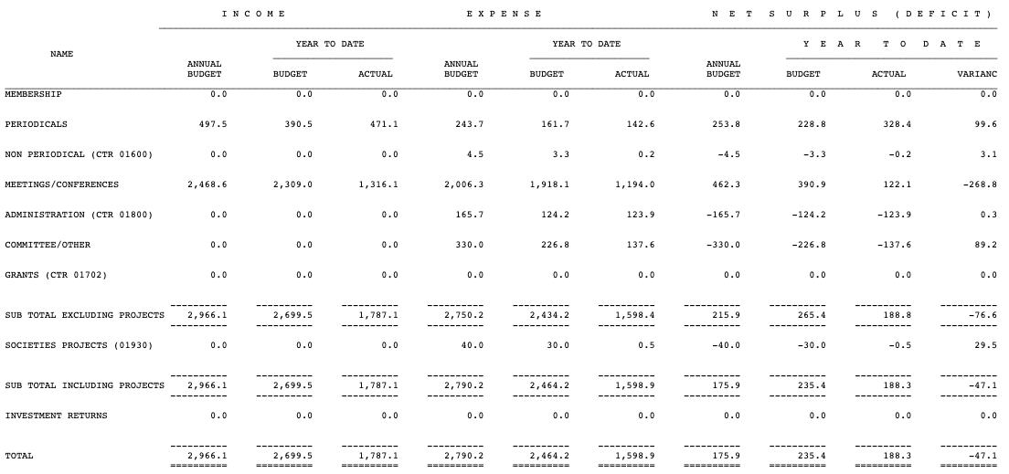
Current Status 2020
Oct. & Dec. issue
Extra 95K to cut backlog

Slide 3
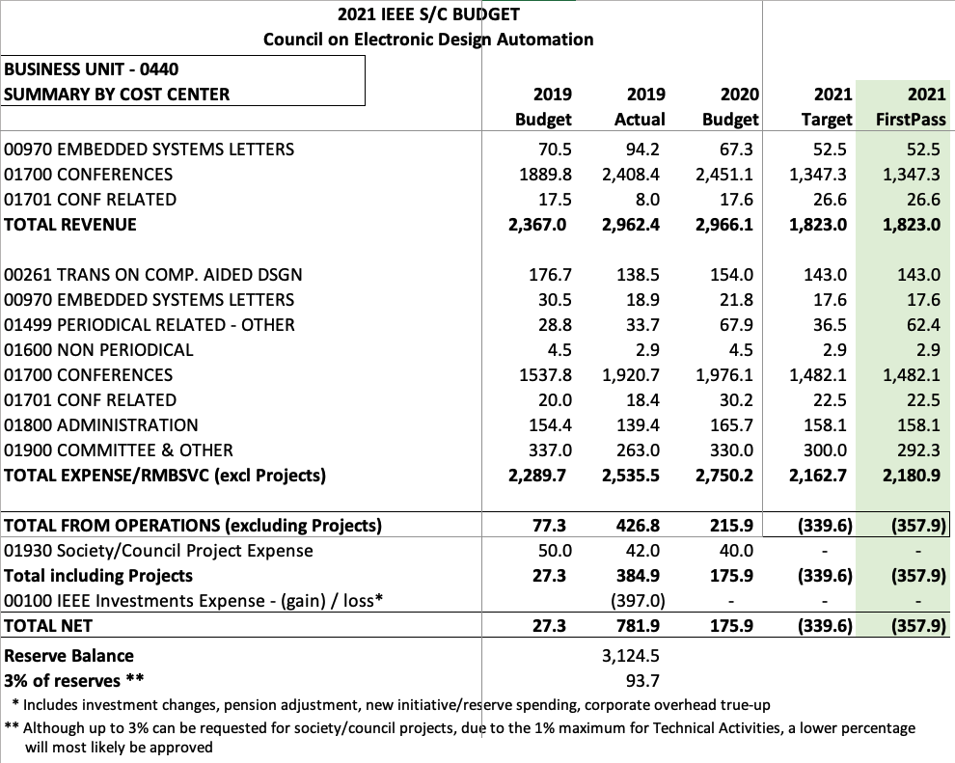
Target budget
From IEEE:
Negative 360K
Conferences (forecast):
Revenues: 50% 2020
Expenses: 75% 2020

Slide 4
Budget 2021
CEDA Luncheons ~ 45K * ASP-DAC, DATE, DAC, ICCAD
Distinguished Lecturer ~ 20K *
Awards ~ 16K
Local Chapters ~ 30K
Technical committee ~ 23K DATC, SVDTC, TCCPS
Technical committee contests ~ 25K DATE, DAC, ICCAD, SMACD, LPCV ..
Operational ~115K
Secretarial services
Editorial services
Web & Media ~ 12K
Volunteer travel 30K
Other expenses
Smart Cities initiative 20K
IoT initiative 5K

