Slide 1
IEEE CEDA Executive Committee Meeting at ICCAD 2018
Hilton San Diego Resort & Spa, San Diego, CA November 4th, 2018

Slide 2
Finance
Cristiana Bolchini/Politecnico di Milano

Slide 3
Status
Financial reserve as of Sep 2018: ~$2.5M
Actual Revenues/Expenses in line with what forecast in the budget
Based on the results of 2017 ($85.7K to spend beyond the budget)
$30K in new activities
More funds on the activities in the budget
Additional Executive Committee expenses to travel (and also attend sponsored events)

Slide 4
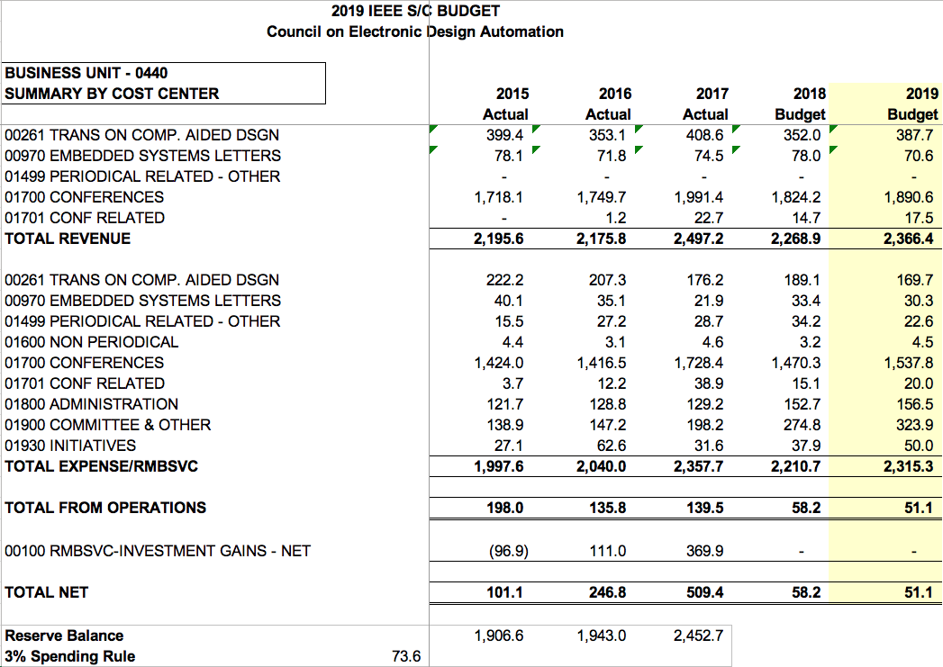
Budget 2019 – soon to be approved

Slide 5
Activities sponsored by CEDA
PhD Forum @ DATE
IoT Student Challenge @ DATE
Diversity in EDA @ DATE
CAD-Contest @ ICCAD
IoT Summer School
CPS Summer School
DAPE workshop
Student support @ LATS
Student support @ ESWeek
EDA Competition @ SMACD
DATC
SVDTC
TCCP
CEDA Luncheon @ ASP-DAC/DATE/DAC/ICCAD
Distinguished Lecturer Program
Awards
Phil Kaufman
Local chapters
South Brazil Shanghai
Hong Kong Taipei
Central Illinois Spain Section
All Japan
P
P
P
P
P

