Slide 1
Wi-Fi Access
Network Name: SDMBR Conference
Password: ICCAD22

Slide 2
Agenda (Pacific Standard Time)
7:00-8:30 AM: Breakfast
8:00-8:30 AM: Welcome and Call to Order (Nam/Vatajelu)
8:05-8:30 AM: Governing Document Changes (Nam/Vatajelu)
IEEE and CEDA membership requirements for EC’s Outstanding change to MTO listing
8:30-9:00 AM: Finance (Zapater)
9:00-9:30 AM: DAC (Silveira)
2022 and 2023 updates
DAC Representative selections and term recommendations
9:30-10:00 AM: Awards (Gielen/Nam/Osborn)
Kaufman Award Planning
Awards Manual
10:00-10:30 AM: Activities (Ho)
10:30-11:00 AM: Initiatives (O’Connor)
11:00-11:30 AM: Conferences (Bolchini)
11:30 AM-12:30 PM: Lunch
12:30-1:00 PM: Publications (Henkel)
1:00-1:30 PM: New/Old Business (All)
Future meeting dates and format for EC and BoG meetings
EC-Sunday, 16 April in Antwerp, Belgium, co-located with DATE 2023
EC/BoG- Sunday, 9 July in San Francisco, CA, USA; co-located with DAC 2023 (host offsite and not in Moscone?)
Format:
2-day meetings?
BoG meets twice a year (financial implications for Member Society Reps and CEDA)
SSSC for Currents (see email)
Administrative Updates (Osborn/Campin)
Dinner at Cannonball
3146 Mission Blvd., Belmont Park, CA 92109
Meet at 6:30 PM in the Lobby
ICCAD EC ACM Overhead Discussion
1:30 PM: Adjourn

Slide 3
President’s Report
Gi-Joon Nam
30 October 2022

Slide 4
Welcome to ICCAD 2022 CEDA EC Meeting
Schedule
8:00 - 11:30 am : Meeting
11:30 am - 12:30 pm: Lunch
12:30 pm - 1:30 pm: Meeting (Old/New Business)
7:00 pm: Dinner @ Cannonball 3146 Mission Blvd, Belmont Park, CA 92109
Key issues from my perspectives
Governing document changes
Kaufman award planning / status
DAC representative selection & term policy
ICCAD budget issue on ACM overhead fees
2023 EC & BoG meeting dates & formats

Slide 5
Governing Documents Changes (1)
IEEE and CEDA membership requirements for ECs
IEEE recommends to add the following language to the governing document
“Each representative and officer on the Council must be an IEEE graduate student member, member, senior member or fellow and a member of the Council”.

Slide 6
Governing Documents Changes (2)
Changes to MTO listing
In 2021, Agnieszka Dubaj moved to approve the removal of the listing of “Member Technology Organization” from the IEEE CEDA Bylaws.
Intention was to make it easier to add/remove Member Technology Organizations without having to make a formal change with IEEE each time.
Two issues:
In Bylaws, the conferences and journals are also listed in ”Member Technology Organizations” section
The CEDA constitution states that each Member Technology Organization has a voting representative on the Board of Governors.
If the Member Technology Organizations appoint presentations with voting rights to the BoG, they do need to be listed in the Bylaws so that the voting rights of each MTO are codified in the governing documents.
Recommendation:
Leave the Bylaws as written, and invite each MTO to the next BoG meeting at DAC

Slide 7
Kaufman Award Dinner Planning Procedures
The MOU is signed by ESDA and CEDA and in place since 2019.
The timing, venue and theme of the event will be agreed to by the Sponsors.
The production and management of the event will be managed by ESDA.
Both sponsors will actively solicit supporting sponsorships to offset the costs of producing the Kaufman Award Dinner.
The net costs or surpluses from the event will be shared equally by the Sponsors.
Since Sept, CEDA and ESDA formed the Kaufman Dinner Committee and have been working together to plan the dinner event in 2023.

Slide 8
Kaufman Dinner Event
2022 Recipient: Dr. Giovanni De Micheli
When: Feb 23, 2023 (the last day of 2023 International Solid-State Circuit Conference)
Where: The GlassHouse in San Jose
CEDA needs 1) to promote the event more via connections to ISSCC organizers and attendees, and 2) to recruit more industrial sponsors
International attendees
Industrial sponsors from design houses & foundries
More CEDA tables?

Slide 9
Finance
Marina Zapter
30 October 2022

Slide 10
Budget 2023 – After first pass submission
First-pass budget was submitted to IEEE in August
Some good news:
IEEE automatically increased by 30% the budget for all travel-related expenses
This applies to accounts AC_505002 (meals), AC_505004 (Volunteer travel)
It increases the budget of our following activities
Meetings & accommodations : 10K → 13K (meeting expenses at DAC, DATE, ICCAD)
Volunteer travel : 40K → 52K
CEDA Luncheons : 43K → 56K
Distinguished Lecturer : 25K → 26K
Submission of many initiatives (8 initiatives, amounting a total of 98K)

Slide 11
Budget 2023
Contractors (Editorial services): ~67K
Operational - Conference Catalyst: 62K (secretary) + 10K (web) + 2K (Zoom)
Meetings & accommodations : 10K → ~13K
Volunteer travel : 40K → ~52K
CEDA Luncheons ~ 43K → ~56K ASP-DAC, DATE, DAC, ICCAD
Distinguished Lecturer ~ 25K → ~26K
Awards ~ 27K
Local Chapters 22K
Technical committee 33K DATC, SVDTC, TCCPS
Technical committee contests ~ 25K DATE, DAC, ICCAD, SMACD, LPCV ..
Initiatives: 40K → ~98K
Advertising: 25K

Slide 12
Initiatives approved (2023)
98k approved for 2023
Student travel grant → from 20k to 30k
Young People Programme (YPP) at DATE 2023 → 10k
CEDA SS at Smart Cities Conf. → 10k
CEDA SS at World Forum on IoT → 10k
EDA Summer camps → 15k
Design challenge on Open-Source EDA → 8k
Open-Source Impl. of HW Sec. Attacks and Counterm. → 15k

Slide 13
Initiatives approved (2022)
2022 New initiatives all approved. Forecast Dec’22:
~10k for student travel grant (20k were available)
5k CPS Summer school
10k SS Rebooting computing (Dec’22)
(3k TinyML)
No expected use of budget of other initiatives
DAPE workshop, ML-CAD, Diversity in EDA

Slide 14
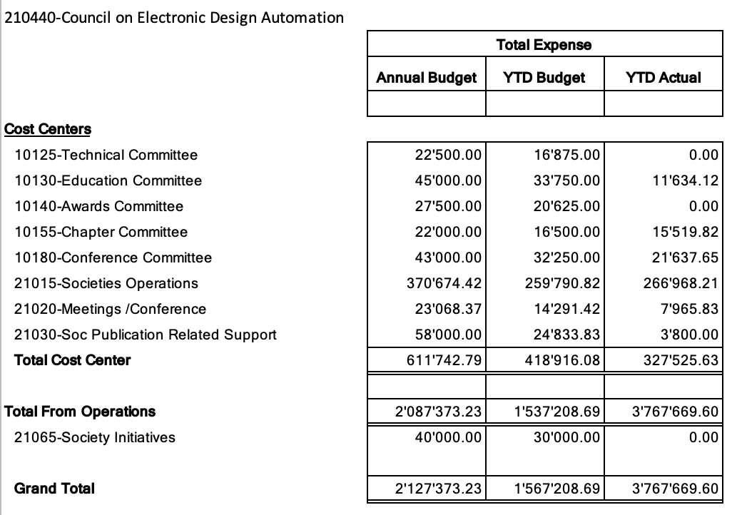
Finances 2022 Status (Sept.’22)
Underspending in all categories, except in volunteer travel
1 “extra” EC meeting → DAC Dec’ 21 absorbed by 2022 budget.
Still, we will not use (by far) all technical activities budget

Slide 15
An opportunity for housekeeping
Cost Centers and Accounts reevised with IEEE financial contact point
This was a missing “todo” after NextGen migration
Getting slowly rid of the account: AC_518019 “Unidentified expenses and other misc”
Fixed incorrect mappings from “Concur trip purposes” to accounts
Simplified, rendudancies removed
Check next slide for details!

Slide 16
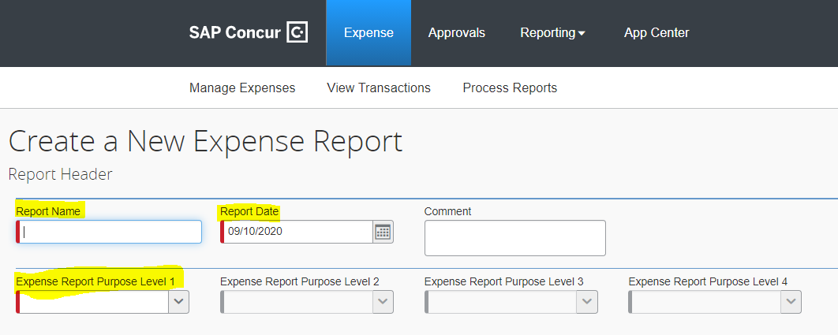
Reporting expenses in Concur
Purpose of the trip: fill-it in correctly so that your expense report reaches me!
When you travel or report expenses for CEDA:
For EC members → Excom
For BoG members → Adcom
For students with a Travel Grant → Student Support
For initiatives (speakers reimbursement) → Initiatives
Spent some time writing guidelines, ask if you have doubts

Slide 17
DAC 2022 & 2023 Updates
L. Miguel Silveira
Oct. 30th 2022

Slide 18
DAC 2023
CEDA chairs the Sponsor’s Committee
60th DAC started with high expectations, goal is to celebrate 60th edition
Expectations trimmed down as prices have risen
Inflation is high, costs is San Francisco sky high
Exhibition still showing very slow signs of improvement
Budget still being discussed, but initial estimates do not look good (at best we are seeing low to no profit)
ACM is pushing very hard for extensive changes, budget reductions; current budgets are draining their coffers (ACM will still charge some overhead).
DAC is tied to San Francisco for 2024 as well, so no relief there…

Slide 19
DAC 2023 and beyond
Eventually budget cuts will come into play to ensure break even
Not very clear how to satisfy all requirements going forth
Keep the conference high-profile, visibility
Return to profitability
Keep an exhibition on-going
A distinguishing factor from other conferences, an attractive factor for young students
Maintain or increase industry participation
Consolidation is taking its toll, economy predictions do not help
Expenses are increasing, income not matching same increase

Slide 20
DAC 2023 and beyond
Many ideas being floated
Fall meeting had an interesting brainstorming session
Identify additional revenue streams
Engineering Track? Beef up the engineering track and attract more practitioners
Lessens the “academic”/scientific profile?
Monetize other aspects of conference/exhibition
Livestream keynotes? I Love DAC?
Reduce costs:
EC costs (in-person meetings, registration waivers, etc.)
Change venue (where?)

Slide 21
DAC CEDA Representation
L. Miguel Silveira
30th Oct. 2022

Slide 22
DAC CEDA representation
IEEE CEDA and ACM SIGDA are DAC’s sponsors
Each organization elects two members to the Sponsors’ Committee
Current representatives from CEDA are the President-Elect and the Past-President
President not included, already has multiple responsibilities
Problematic as it ensure no continuity; President-Elect is in for 2 years, then leaves then comes back as Past-President (lost track of things for 2 years)
Both representatives change every two years
Not an ideal situation at a time when the conference needs considerable guidance and attention

Slide 23
Proposal for change of representation
Need to ensure continuity, hopefully such that one of the two representatives stays longer than 2 years and both do not change at the same time (overlapping mandates)
Need to keep additional President’s responsibilities at a minimum
Suggestion:
Representatives would be Past-President (leads CEDA team) and President
President becomes Past-President, thus stays 4 years but has less responsibilities in the 1st 2 years

Slide 24
Motion(s)
CEDA DAC representatives will be the Past-President and the current President. The Past President takes the leading role and also leads the Sponsor’s committee when IEEE assumes that role.
Change in representation to come into effect in 2024

Slide 25
Awards
Georges Gielen, Gi-Joon Nam, Amanda Osborn
30 October 2022

Slide 26
Technical Activities
Tsung-Yi Ho
30 October 2022

Slide 27
Agenda (Pacific Standard Time)
7:00-8:30 AM: Breakfast
8:00-8:30 AM: Welcome and Call to Order (Nam/Vatajelu)
8:05-8:30 AM: Governing Document Changes (Nam/Vatajelu)
IEEE and CEDA membership requirements for EC’s Outstanding change to MTO listing
8:30-9:00 AM: Finance (Zapater)
9:00-9:30 AM: DAC (Silveira)
2022 and 2023 updates
DAC Representative selections and term recommendations
9:30-10:00 AM: Awards (Gielen/Nam/Osborn)
Kaufman Award Planning
Awards Manual
10:00-10:30 AM: Activities (Ho)
10:30-11:00 AM: Initiatives (O’Connor)
11:00-11:30 AM: Conferences (Bolchini)
11:30 AM-12:30 PM: Lunch
12:30-1:00 PM: Publications (Henkel)
1:00-1:30 PM: New/Old Business (All)
Future meeting dates and format for EC and BoG meetings
EC-Sunday, 16 April in Antwerp, Belgium, co-located with DATE 2023
EC/BoG- Sunday, 9 July in San Francisco, CA, USA; co-located with DAC 2023 (host offsite and not in Moscone?)
Format:
2-day meetings?
BoG meets twice a year (financial implications for Member Society Reps and CEDA)
SSSC for Currents (see email)
Administrative Updates (Osborn/Campin)
Dinner at Cannonball
3146 Mission Blvd., Belmont Park, CA 92109
Meet at 6:30 PM in the Lobby
ICCAD EC ACM Overhead Discussion
1:30 PM: Adjourn

Slide 28
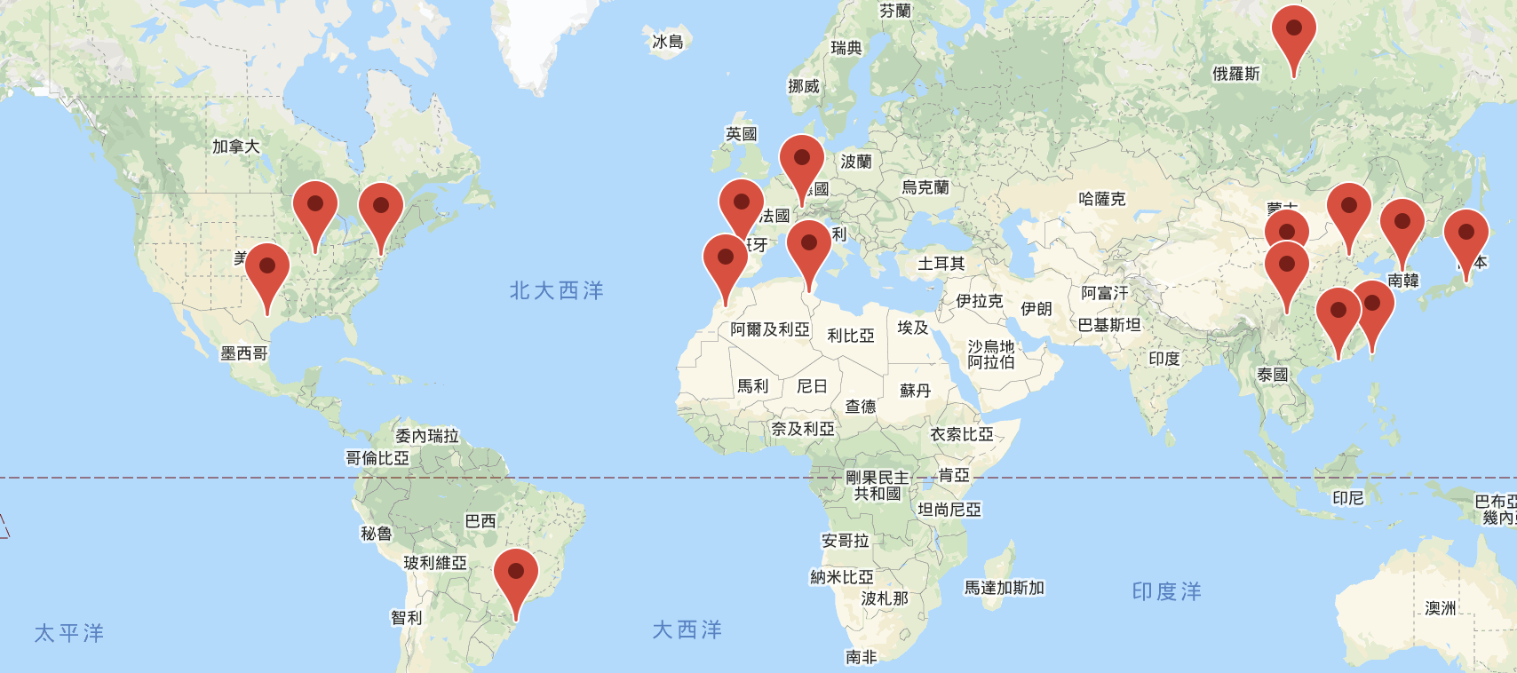
CEDA Chapters
16 Chapters
5 Student Chapters
Beijing
Central Illinois
Central Texas
Chengdu
Hong Kong
Japan
Montreal
Morocco
Pennsylvania
Seoul
Shanghai
South Brazil
Spain
Switzerland
Taipei
Tunisia

Slide 29
Petition of Student Chapter
We always welcome new student branch chapters and volunteers of CEDA. We want to ensure that CEDA is the right Council for the students’ interested areas to get sufficient support from the right organization.
Please provide more information on the statements and plans for CEDA review and approval, including expanding on your plans for:
Industrial workshops
company visits
CAD programming contests
Summer schools/camps
Academic seminars related to EDA
The scope of EDA includes not only the use of EDA/CAD tools to design integrated electronic circuits and systems, but also the theory, implementation, design, analysis, and verification of ICs, hardware, and embedded software up to and including complete working systems. EDA is not just using tools, but more on developing tools for circuit and system designs. Our required background training is algorithms and data structures, with domain knowledge on logic and circuit designs. If you want to use EDA tools or design circuits, then CAS or SSCS should better fit your needs; and the two societies could provide you with better resources.
To familiarize the fundamentals of EDA, students are encouraged to reach out to our seven member societies first, which includes Antennas and Propagation, Circuits and Systems, Computer, Electron Devices, Electronics Packaging, Microwave Theory &Techniques, and Solid-State Circuits Societies.

Slide 30
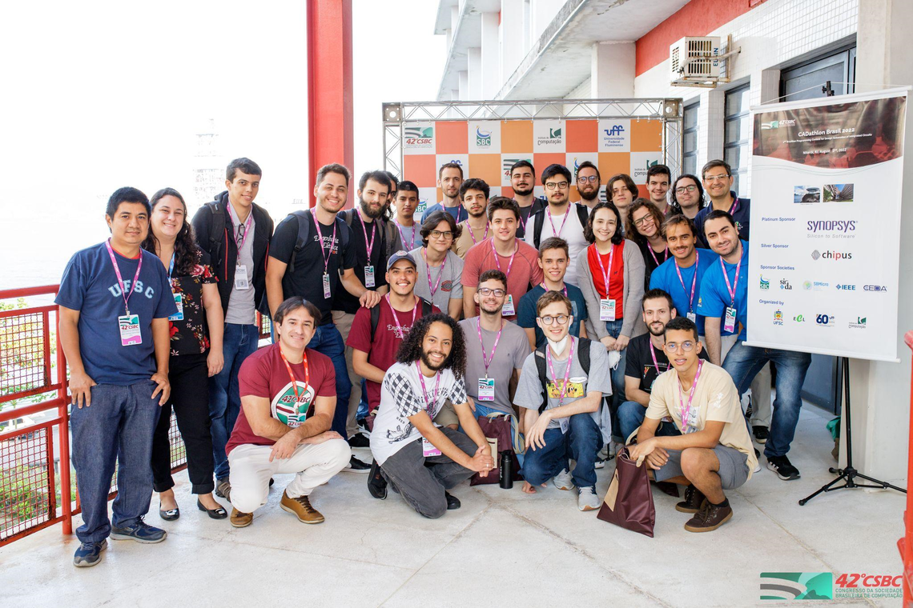
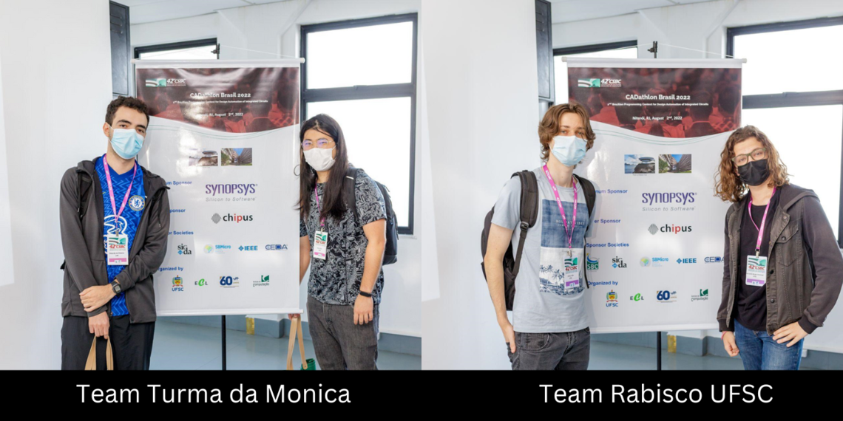
Brazil Chapter - CADAthlon Brasil
15 two-person teams of students coming from different regions of Brazil worked to solve 6 practical problems on classical EDA topics such as circuit design & analysis, physical design, logic synthesis, high-level synthesis, circuit verification, and application of AI to design automation. The problems were prepared by a team of researchers from industry and academia.
1st Place – Team Turma da Monica from the University of Brasíli, and was formed by Enzo Yoshio Niho and Eduardo Quirino de Oliveira
2nd Place – Team Rabisco UFSC from the Federal University of Santa Catarina and was formed by Arthur Joao Lourenço and Bernardo Borges Sandoval.
The top two teams were awarded money prizes offered by Synopsys.
R$ 1,500.00
R$ 1,000.00

Slide 31
Hong Kong Chapter - EDAthlon
26 two-person teams of students coming from different regions of China worked to solve 5 practical problems on classical EDA topics online.

Slide 32
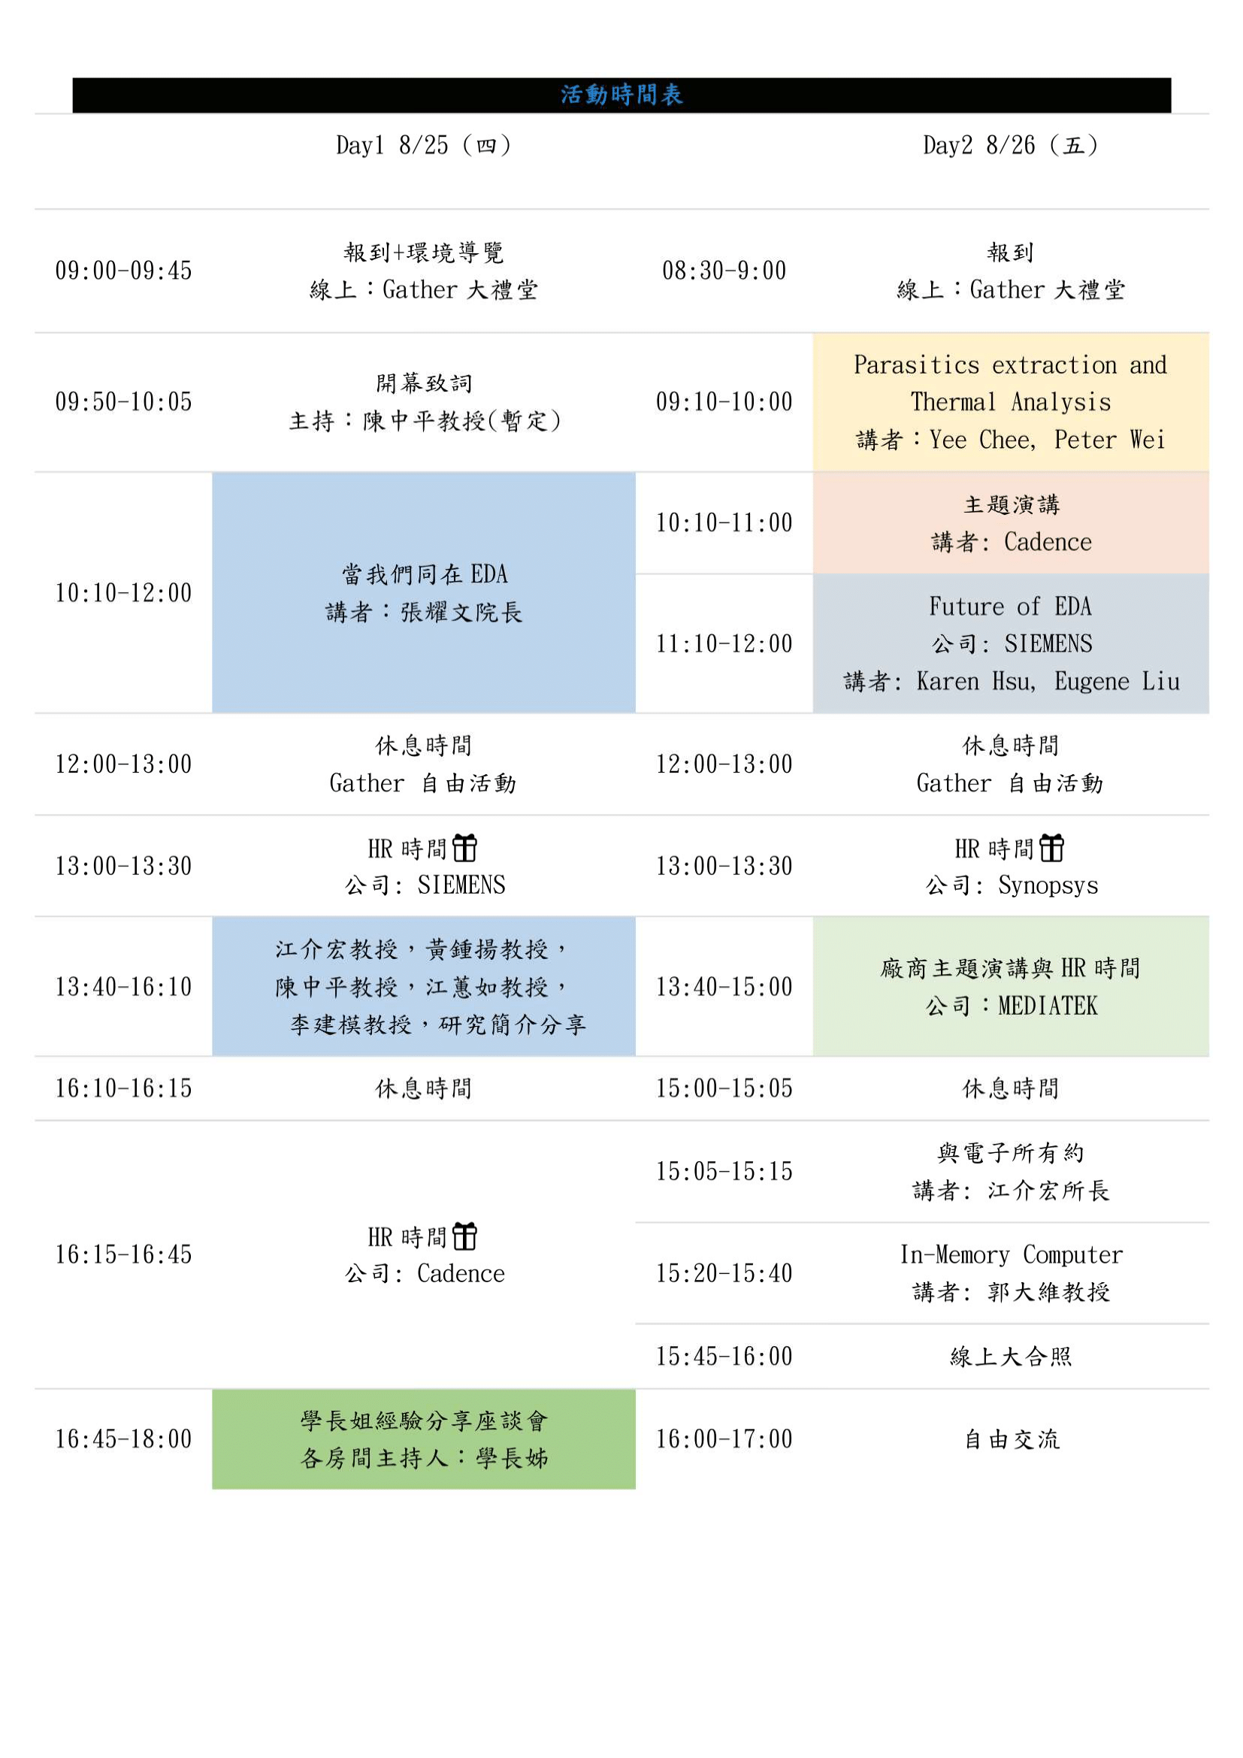
Taipei Chapter – EDA Summer Camp
74 students for 2-day summer camp and the event is held in hybrid mode.
Research talks, tutorials, experience sharing, company talks.
They had company visits and a mini programming contest when the event is held physically.

Slide 33
CEDA Technical Committees
DATC (Design Automation Technical Committee)
Chair: Jinwook Jung, IBM
SVDTC (System Validation and Debug Technology Committee)
Chair: Chinna Prudvi, Intel Inc.
TCCPS (Technical Committee on Cyber-Physical Systems)
Chair: Shiyan Hu, University of Southampton
TTTC (Test Technology Technical Council)
Chair: Peilin Song, IBM
Hardware Security and Trust Technical Committee (HSTTC)
Chair: Gang Qu, University of Maryland
Awards, Tools, Standards, Outreach, etc.

Slide 34
TCCPS
The Technical Achievement Award
John A. Stankovic, University of Virginia
For pioneering contributions to real-time systems, sensor networks, and smart health
Distinguished Leadership Award
Feng Zhao, Tsinghua University and Eight Roads Ventures
For pioneering contributions to the theories and practices of cyber-physical systems and inspirations to upcoming researchers, engineers and entrepreneurs
Early Career Award
Pierluigi Nuzzo, University of Southern California
For outstanding works with high potential in high-assurance design and design automation of cyber-physical systems, including requirement analysis, architecture exploration, and contract-based design
Industrial Technical Excellence
Xinping Guan, Cailian Chen, Bo Yang, Yazhou Yuan, Shanying Zhu, Qimin Xu, Yuan Lin, Yuxiong Xia
For the contribution to sensing-communication-control orchestrated design technologies for industrial cyber-physical systems and applications in smart manufacturing

Slide 35
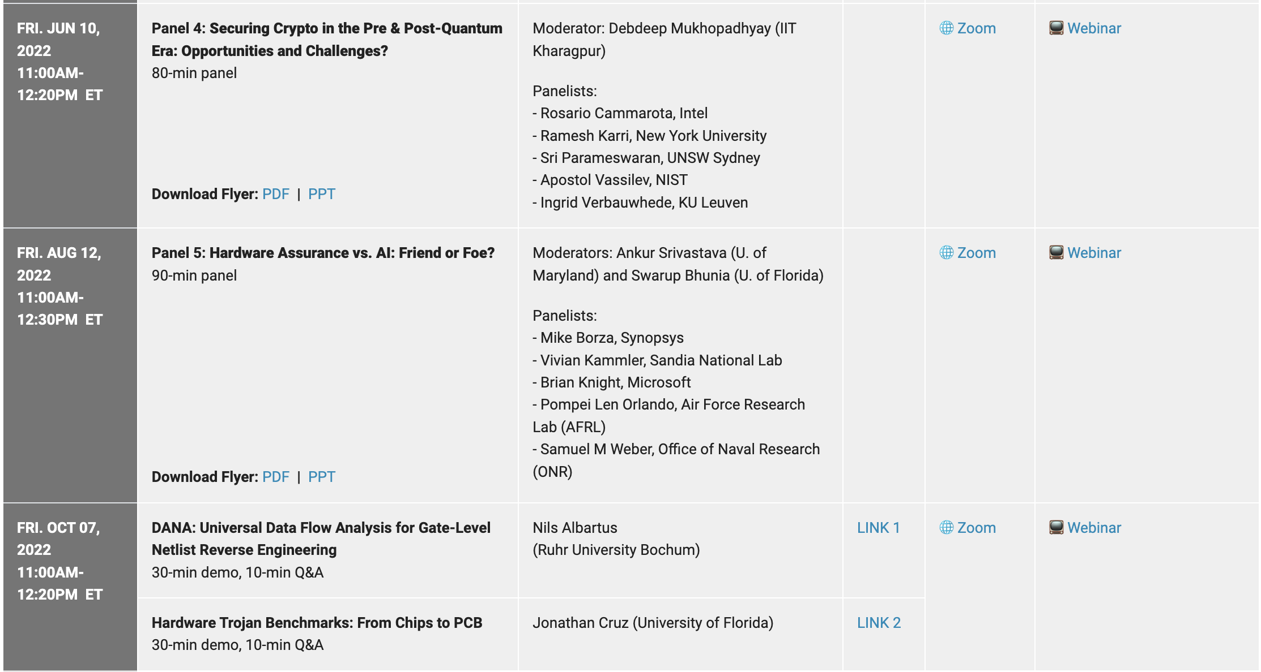
HSTTC
CAD for Assurance Webinar

Slide 36
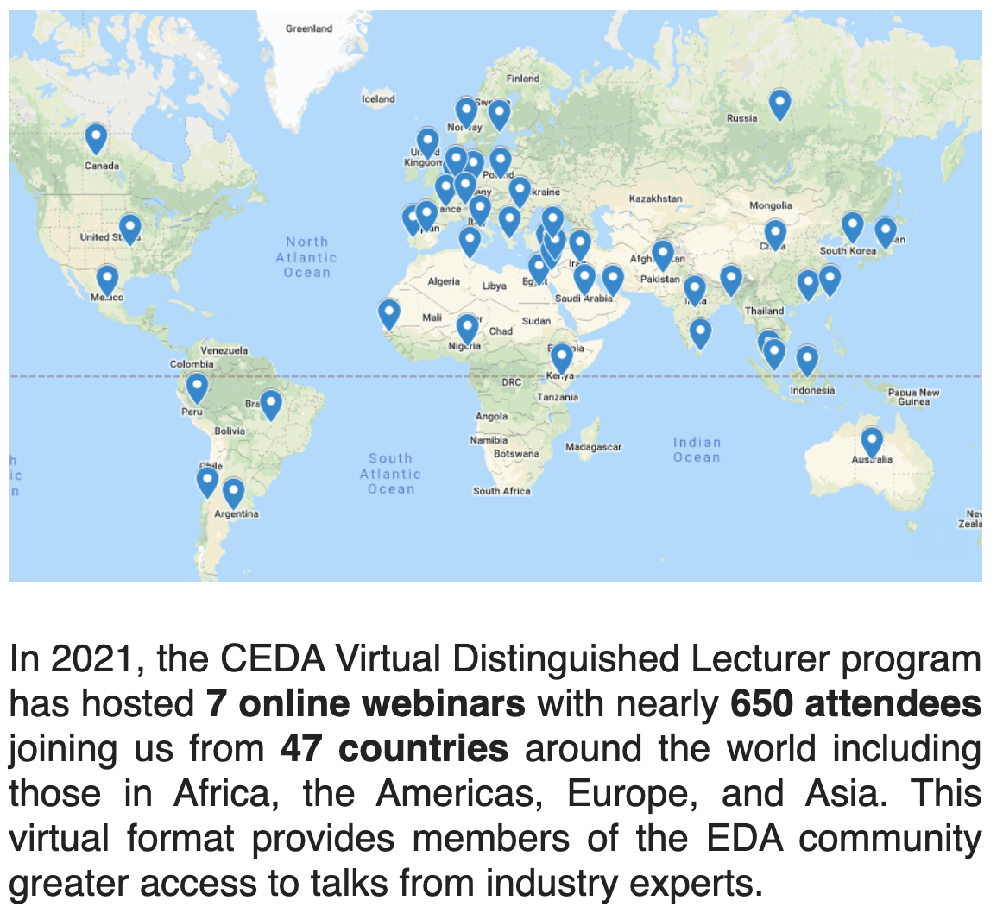
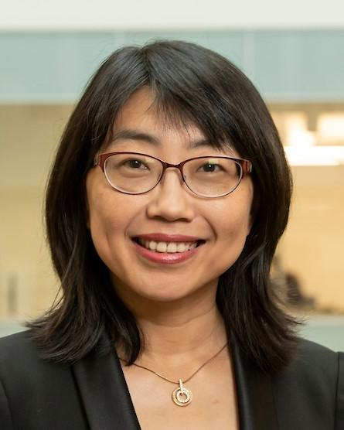
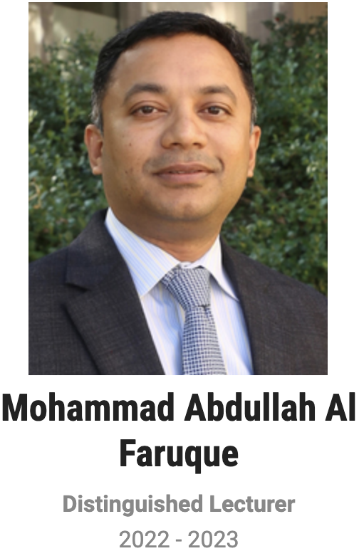
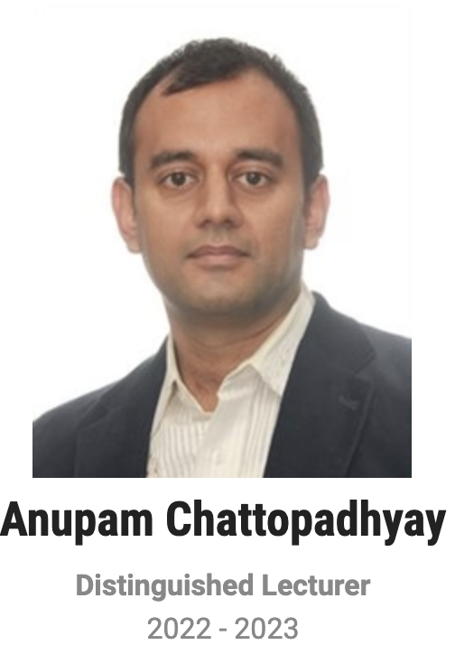
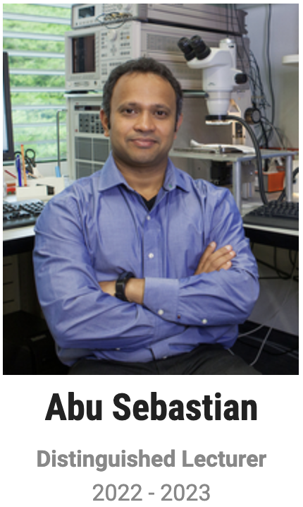
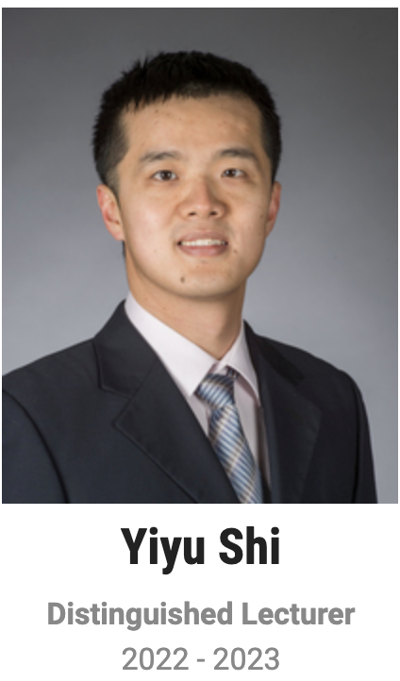
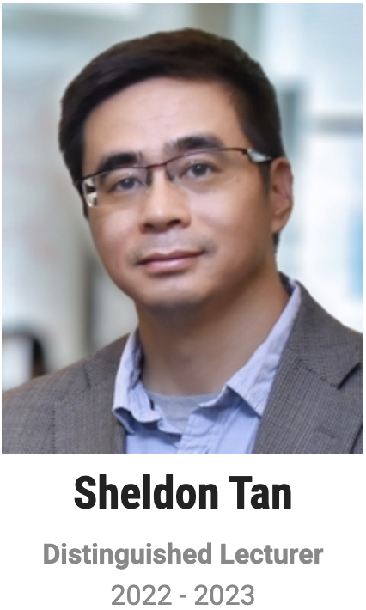
Current Status
Distinguished Lecturer Program
Helen Li
2022-2023

Slide 37
Current Status
Job Fair@ICCAD
Participating companies
- IBM Research
- Infineon Technologies
- Futurewei Technologies
- NVIDIA
- Pacific Northwest National Laboratory (PNNL)
- MediaTek
- Zero ASIC
- Cadence
- Synopsys
52 students have submitted their CV.
Joint event with SIGDA
In-person meetings are Nov. 1st (Tuesday) 5:30 PM PT !
Location: Pavilion, SAN DIEGO MISSION BAY RESORT.
Online session on Nov. 2nd

Slide 38
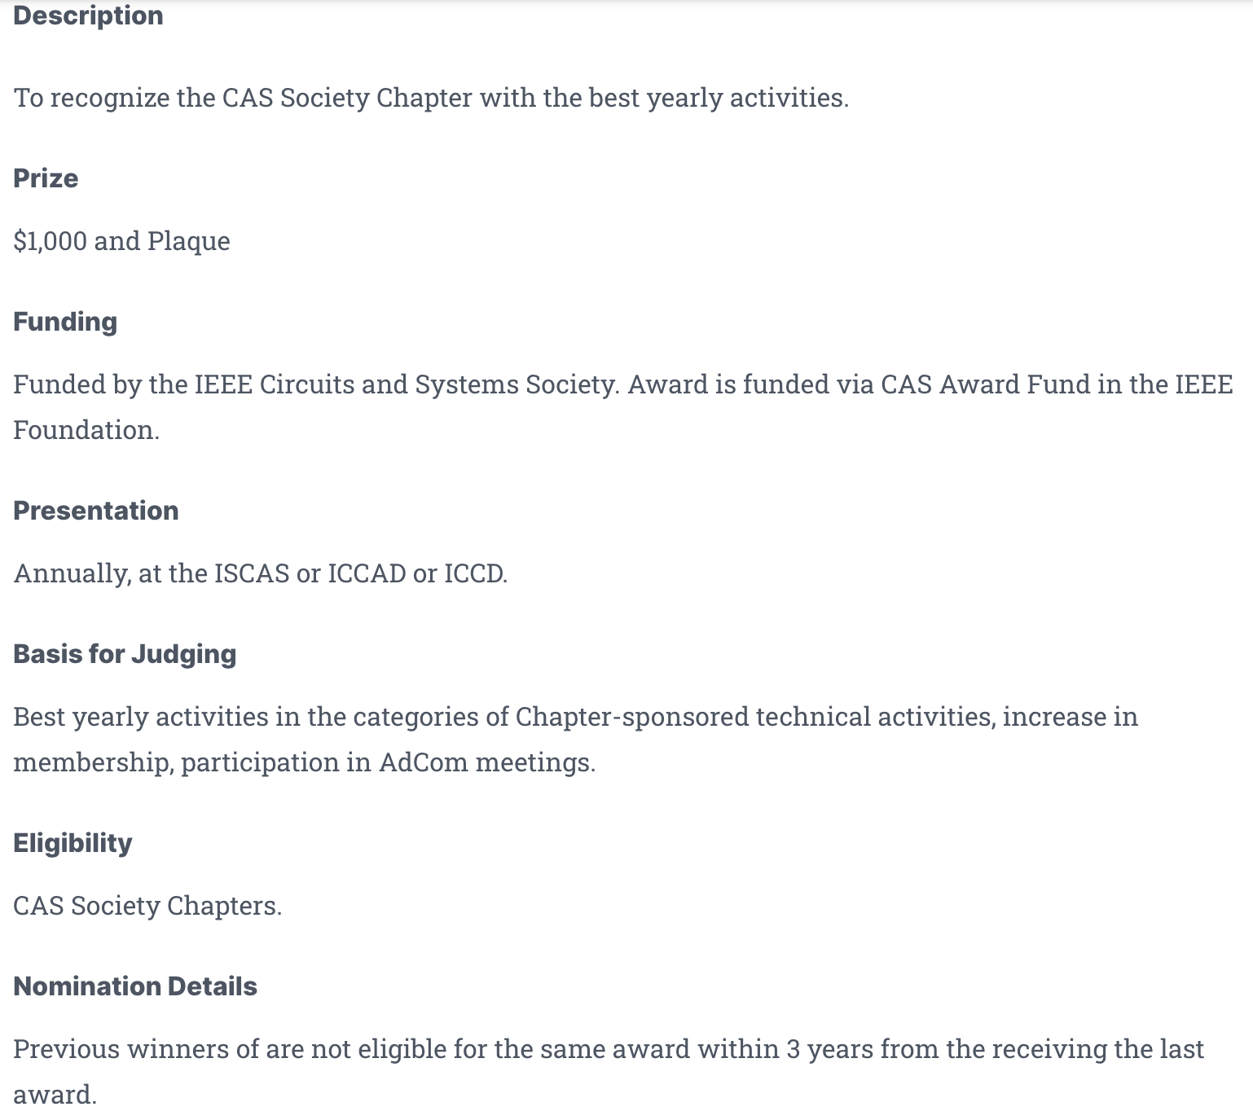
Motion
Chapter-of-the-Year Award
The awards criteria include:
Number and quality of chapter activities
Membership development activities and member growth
Participation in CEDA events, e.g., Distinguished Lecturer Program
Timeliness of reporting and contributions to newsletter.
Prize: $500 and plaque

Slide 39
Motion
Tsung-Yi Ho moves to establish an annual chapter of the year award of $500 USD and a plaque.

Slide 40
Initiatives
Ian O’Connor
30 October 2022

Slide 41
Conferences
Cristiana Bolchini
30 October 2022

Slide 42
Publications
Joreg Henkel
30 October 2022

Slide 43
CEDA Standards Committee
Aparna Dey
30 October 2022

Slide 44
Standards Overview
Mission /Objective
Current Status & Achievements
Challenges /Opportunities
Action Items
Questions

Slide 45
Mission /Objectives
Drive Standardization in advanced EDA topics involving “research”
Solicit proposals from Academia, Researchers and Industry Adv. Research groups
Collaborate/ Joint sponsor w/ IEEE DASC & other Industry Standards organizations/committees
Leverage CEDA Academic Network for CEDA Standards membership

Slide 46
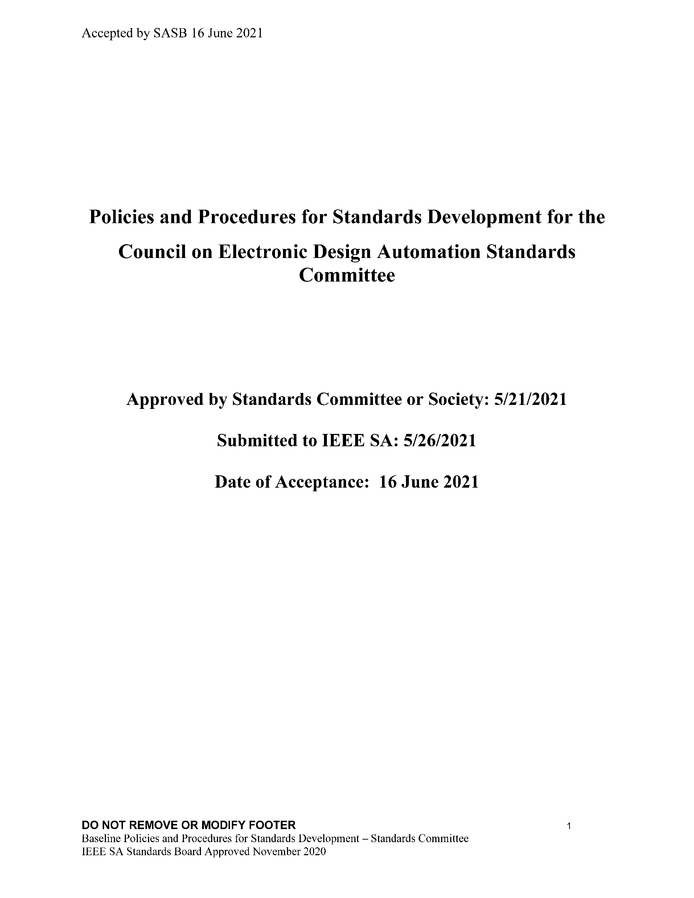
Current Status & Achievements
CEDA SC Leadership - meeting Quarterly
Aparna Dey, chair (CEDA- VP Standards )
Dennis Brophy, Vice-chair
Yatin Trivedi, Secretary
CEDA (CEDA SC) infrastructure – ongoing, slow
CEDA SC public and Collab site - lack of resources
Mission Statement/ Objectives/P&P – done
CEDA SC member drive –
Present to various CEDA Chapters - coordinate with Ty – Q4/22 , Q1/23
IEEE CEDA Events/ forums –Q4/22, Q1/23

Slide 47
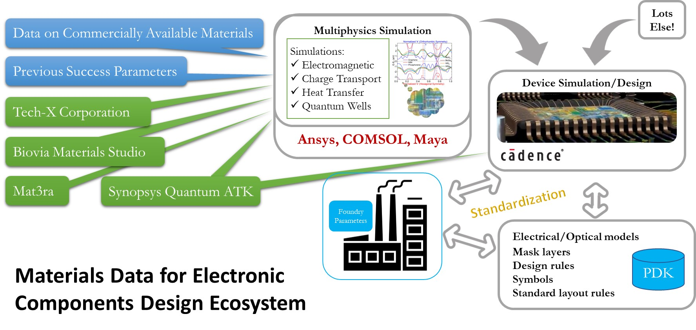
Current Status & Achievements (2)
Received inquiry for a potential new study group
SC Officers met Elizabeth Kujan, a researcher w OppsSpot Consulting
proposal to explore new materials data modeling and methodology of data pipeline for consumption by EDA tools
Form Study group to produce White paper –need CEDA help in starting/managing the study group
Plan call for new Standard Proposals/ Study Groups – Q4
CEDA SC Open-Source Maintainer
Dennis Brophy

Slide 48
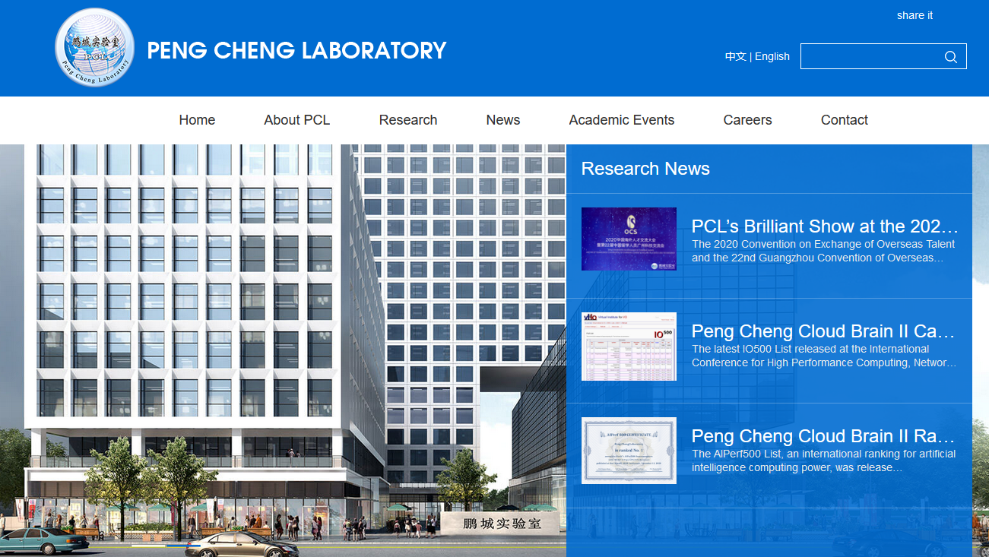
Challenges (1)
Peng Cheng Lab not member of IEEE SA
Informed DASC
No response back from Peng Cheng Lab
Titled: “Semiconductor Devices Modeling & Measurements”
Initiated as an entity project by Xiaoxu Luan at Peng Cheng Laboratory (Shenzhen CN)

Slide 49
Challenges/Opportunities (2)
Aligning Membership recruitment w/ CEDA chapter meetings
Will need to coordinate w/ Academic Calendar
Increasing CEDA/SC visibility with Industry & Academia
Attracting differentiated Standardization proposals/ study group in advanced topics
Industry may not share the advanced research areas
Not compete with DASC standards

Slide 50
Action Items
Work w/ Elizabeth Kujan to complete Materials Data Study Group proposal
Complete CEDA/SC infrastructure /administrative tasks
Increase Membership/ Call for participation drive
Present CEDA/SC Mission @ CEDA Chapter meetings/events
Follow up on adoption of IEEE SA Open platform
Understand and set up new Study Group

Slide 51
Current Published DASC Standards
IEEE Standard | Approve | IEC Dual Logo
1076 VHDL | 2019 | D
1076.1 (VHDL AMS) | 2017 | D
1481 (OLA | 2019 | D
1647 (e language) | 2019
1666 (SystemC) | 2011 | D
1666.1 (SystemC AMS) | 2016 | D
1685 (IP-XACT) | 2014 | D
1734 (Quality IP) | 2011 | D
1735 (IP Encryption) | 2015
1800 (SystemVerilog) | 2017 | D
1800.2 (UVM) | 2020 | D
1801 (UPF) | 2018 | D
2401 (LSI Package Board) | 2019 | D
2416 (System Level Power) | 2019
2804 (SHIM) | 2019 | D

Slide 52
DASC Standards Transferred
IEEE PAR | PAR Approved | Transfer Approved
P2851 (Functional Safety) | 2019 | 2021

Slide 53
DASC Standards Begin Revised
IEEE PAR | PAR Approved | Ballot Expected
P1666 (SystemC) | 2018 | 2022
P1735 (IP encryption) | 2018 | 2022
P1800 (SystemVerilog) | 2019 | 2023
P1801 (UPF) | 2018 | 2023

Slide 54
New DASC Standards
IEEE PAR | PAR Approved | Ballot Expected
P3164 (SA EDI*) | 2022 | 2024
*Security Annotation for Electronic Design Integration.
Scope: This standard addresses security concerns of electrical designs that are integrated into other circuits. The standard defines a methodology that:
(1) identifies elements, such as input or output ports, that can
influence the behavior of a critical section within the design, and
(2) associates known security weaknesses based on the type of
design and/or critical section.

Slide 55
Questions?

Slide 56
Old/New Business
All
30 October 2022

